Slide 1
Welcome

Slide 2
My Presentation Topic Is

Slide 3
Numerical Integration (Trapezoidal Rule)

Slide 4
SUBMITTED TO:
Ayesha Siddika
Assistant Professor,
City University
Department of CSE

Slide 5
Submitted By
Name: Abidur Rahman
ID: 142362004
Batch: 36th
Department: CSE

Slide 6

Introduction
Numerical integration is used to obtain approximate answers for definite integrals that cannot be solved analytically.
Numerical integration is a process of finding the numerical value of a definite integral
When a function y=f(x) is not known explicitly. But we give only a set of values of the function y=f(x) corresponding to the same values of x.

Slide 7
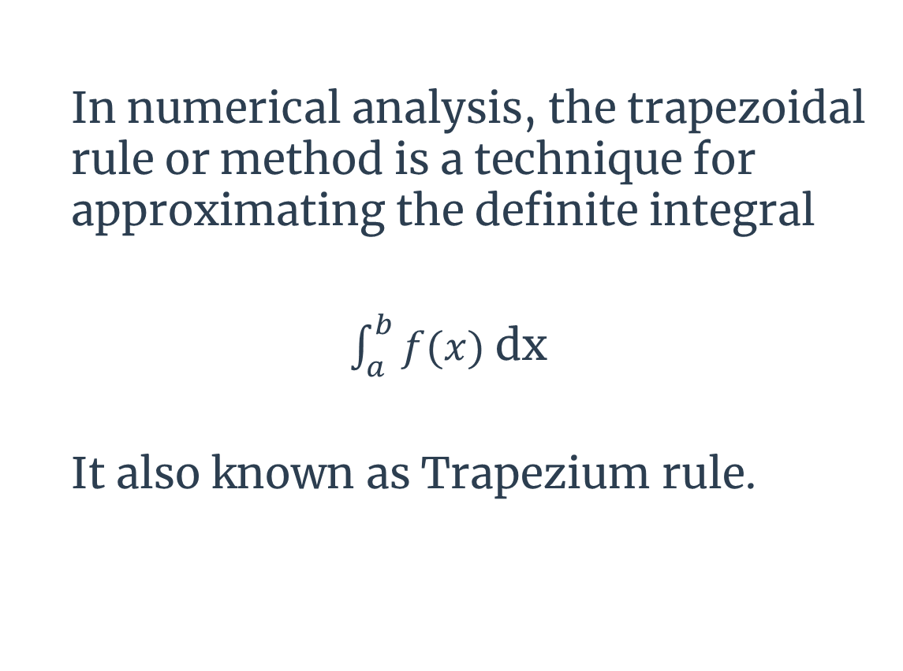
What is trapezoidal method?
In numerical analysis, the trapezoidal rule or method is a technique for approximating the definite integral
$\int_{a}^{b}{f(x)}$ dx
It also known as Trapezium rule.

Slide 8
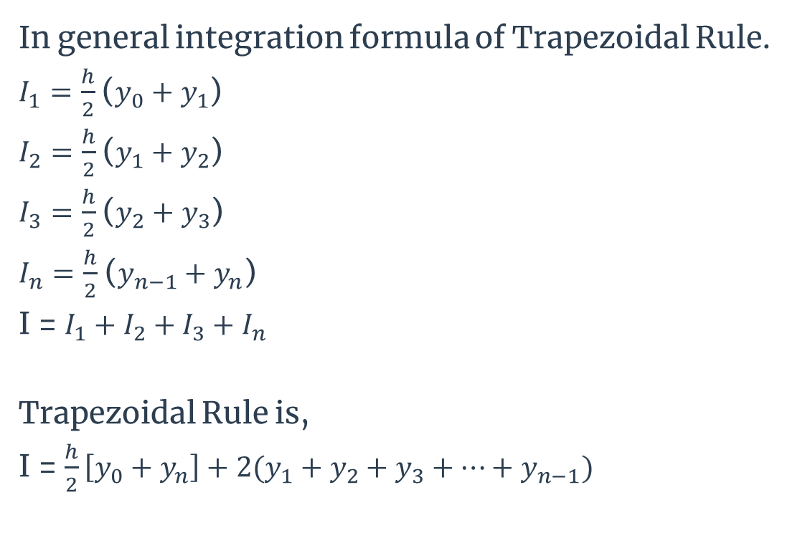
General Formula of integration
In general integration formula of Trapezoidal Rule.
$I_{1}=\frac{h}{2}$ ($y_{0}+y_{1}$)
$I_{2}=\frac{h}{2}$ ($y_{1}+y_{2}$)
$I_{3}=\frac{h}{2}$ ($y_{2}+y_{3}$)
$I_{n}=\frac{h}{2}$ ($y_{n−1}+y_{n}$)
I = $I_{1}+I_{2}+I_{3}+$ $I_{n}$
Trapezoidal Rule is,
I = $\frac{h}{2}\left[y_{0}+y_{n}\right]+2(y_{1}+y_{2}+y_{3}+…+y_{n−1})$

Slide 9
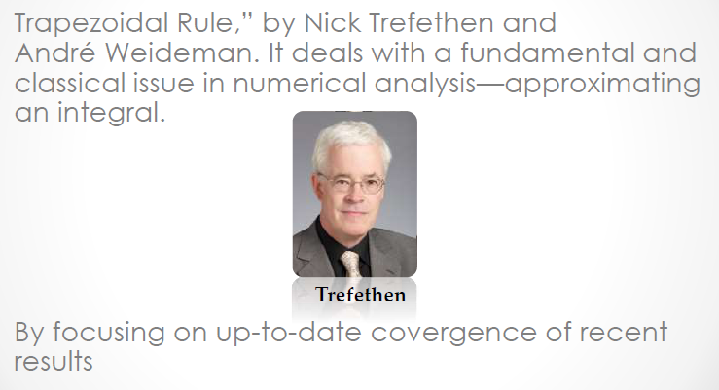
History of trapezoidal method
Trapezoidal Rule,” by Nick Trefethen and André Weideman. It deals with a fundamental and classical issue in numerical analysis—approximating an integral.

Slide 10
Advantages
There are many alternatives to the trapezoidal rule,
but this method deserves attention because of
Its ease of use
Powerful convergence properties
Straightforward analysis

Slide 11
Application of Trapezoidal Rule
The trapezoidal rule is one of the family members of numerical-integration formula.
The trapezoidal rule has faster convergence.
Moreover, the trapezoidal rule tends to become extremely accurate than periodic functions.

Slide 12
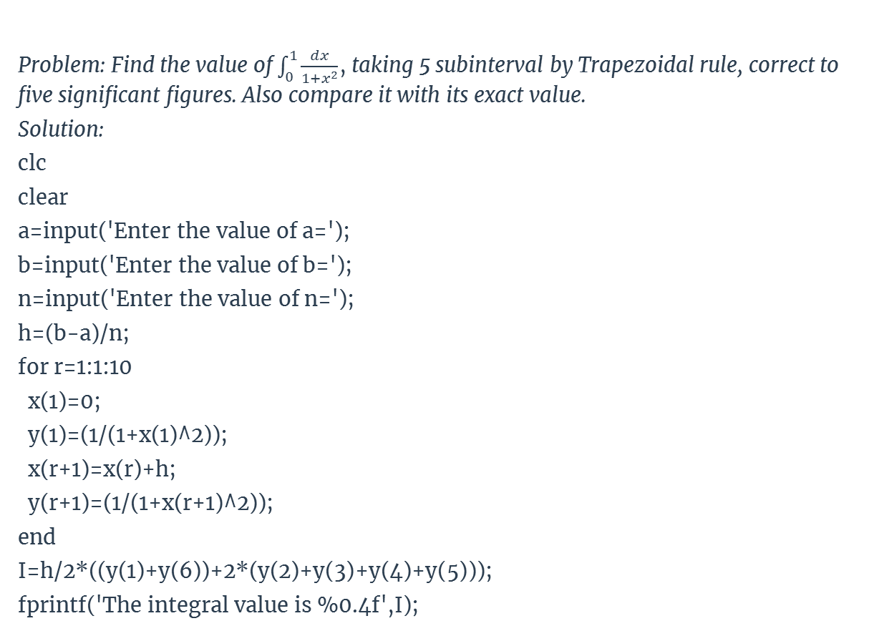
Code for Trapezoidal Method
Problem: Find the value of $\int_{0}^{1}{\frac{dx}{1+x^{2}}}$, taking 5 subinterval by Trapezoidal rule, correct to five significant figures. Also compare it with its exact value.
Solution:
clc
clear
a=input('Enter the value of a=');
b=input('Enter the value of b=');
n=input('Enter the value of n=');
h=(b-a)/n;
for r=1:1:10
x(1)=0;
y(1)=(1/(1+x(1)^2));
x(r+1)=x(r)+h;
y(r+1)=(1/(1+x(r+1)^2));
end
I=h/2*((y(1)+y(6))+2*(y(2)+y(3)+y(4)+y(5)));
fprintf('The integral value is %0.4f',I);

Slide 13
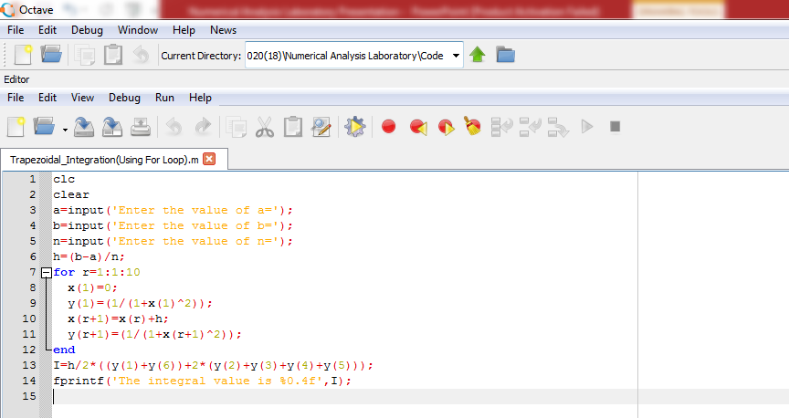
Code using octave

Slide 14
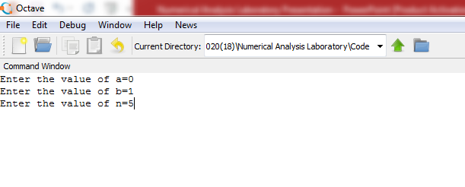
Input the value

Slide 15
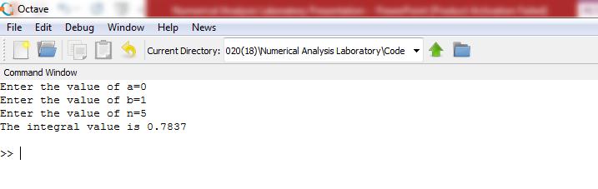
Input & Output value

Slide 16
Conclusion
Trapezoidal Method can be applied accurately for
non periodic function, also in terms of periodic
integrals.
when periodic functions are integrated over their
periods, trapezoidal looks for extremely accurate.

Slide 17
References
http://en.wikipedia.org/wiki/Trapezoidal_rule
http://blogs.siam.org/the-mathematics-andhistory-of-the-trapezoidal-rule/
And various relevant websites

Slide 18


Slide 19
Thanks!
To All

